Slide 1
ANN and Handwritten Character Recognition
Yao zhao

Slide 2
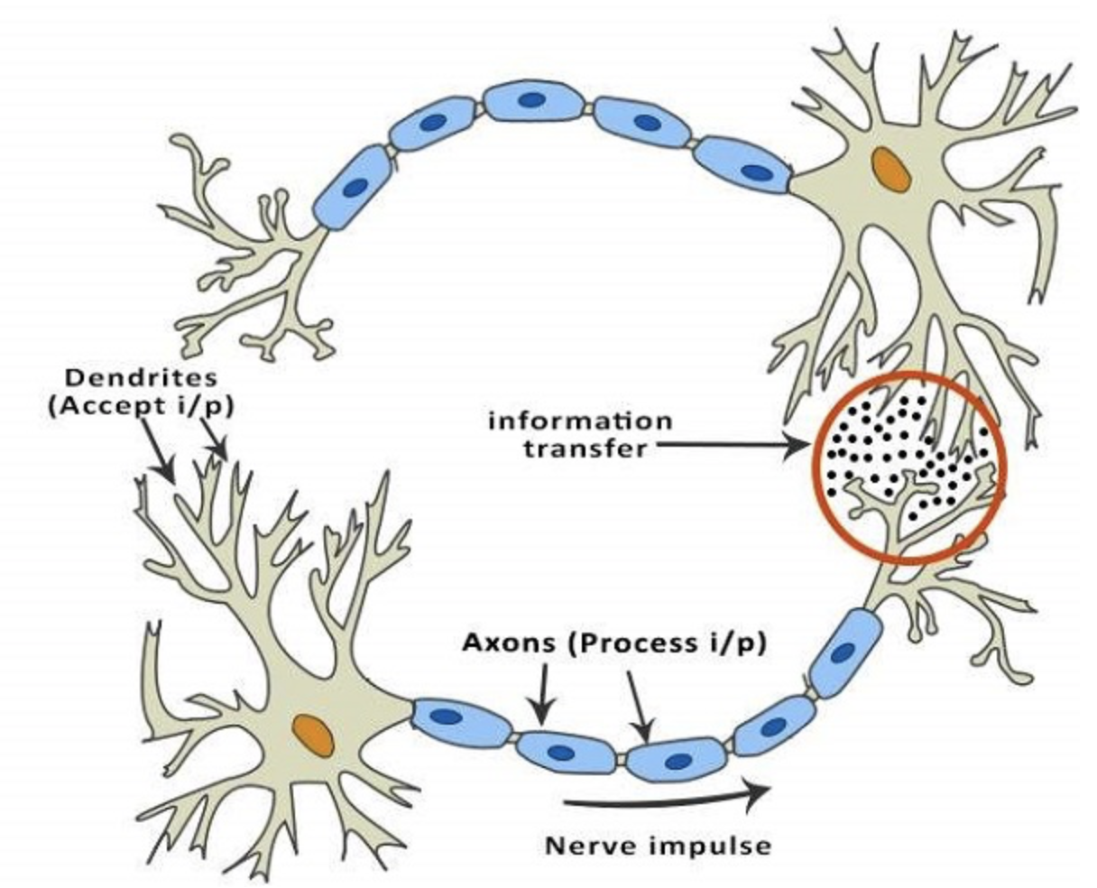
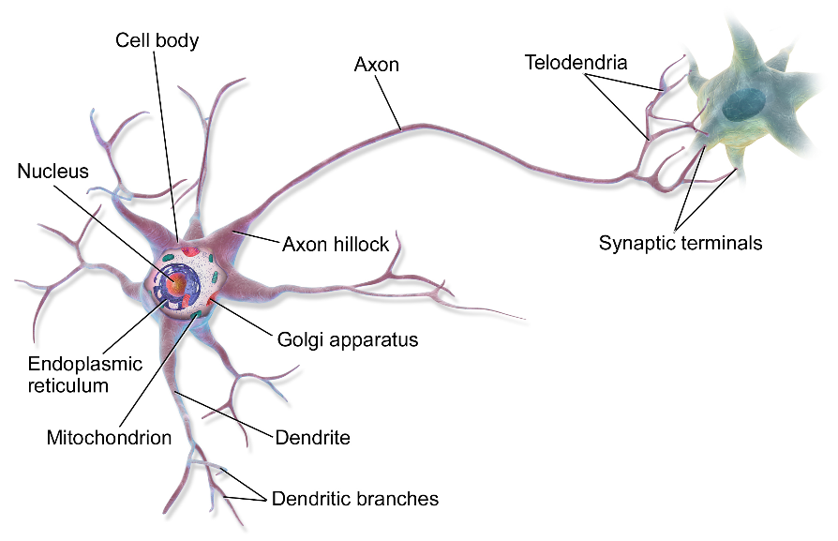
ANN
The study of artificial neural networks was inspired by attempts to simulate biological neural systems (e. g. human brain).
Basic structural and functional unit: nerve cells called neurons
Work Mechanism
Different neurons are linked together via axons (轴突) and dendrite (树突)
When one neuron is excited after stimulation, it sends chemicals to the connected neurons, thereby changing the potential (电位) within these neurons.
If the potential (电位) of a neuron exceeds a “threshold”, then it is activated and send chemicals to other neurons.
Notes:
在生物神经系统中，每个神经元与其他神经元相连，当它“兴奋”时，就会向相连的神经元发送化学物质，从而改变这些神经元内的电位；
如果某神经元的电位超过一个“阈值”（threshold），那么它就会被激活，即“兴奋”起来，向其它神经元发送化学物质。

Slide 3
ANN
A neuron is connected to the axons (轴突) of other neurons via dendrites (树突), which are extensions from the cell body of the neuron.
The contact point between a dendrite (树突) and an axon (轴突) is called a synapse (突触).
The human brain learns by changing the strength of the synaptic connection between neurons upon repeated stimulation by the same impulse.
Notes:
在生物神经系统中，每个神经元与其他神经元相连，当它“兴奋”时，就会向相连的神经元发送化学物质，从而改变这些神经元内的电位；
如果某神经元的电位超过一个“阈值”（threshold），那么它就会被激活，即“兴奋”起来，向其它神经元发送化学物质。

Slide 4
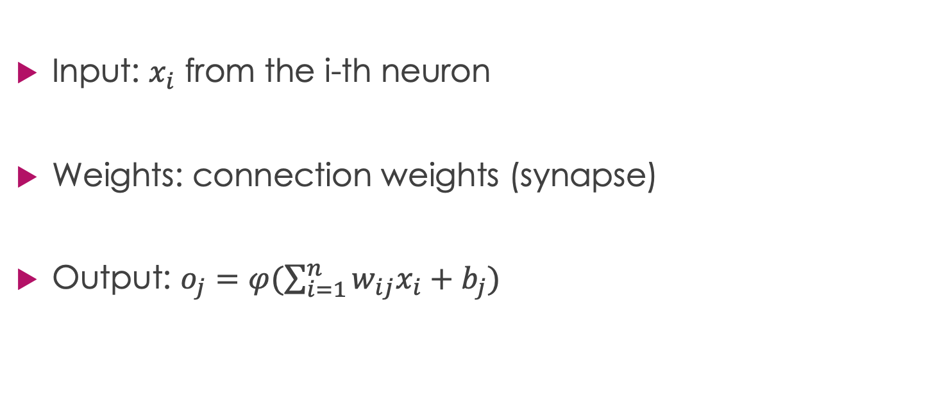
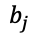
Artificial Neuron Mathematical Model
Input: $x_{i}$ from the i-th neuron
Weights: connection weights (synapse)
Output: $o_{j}=φ(\sum_{i=1}^{n}{{w_{ij}x}_{i}}+b_{j})$
$$b_{j}$$

Slide 5
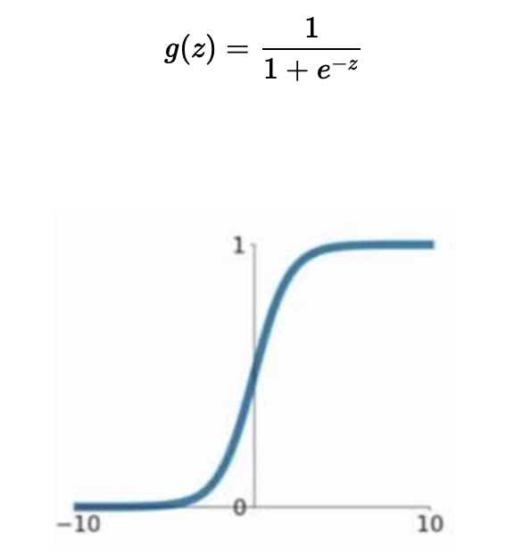
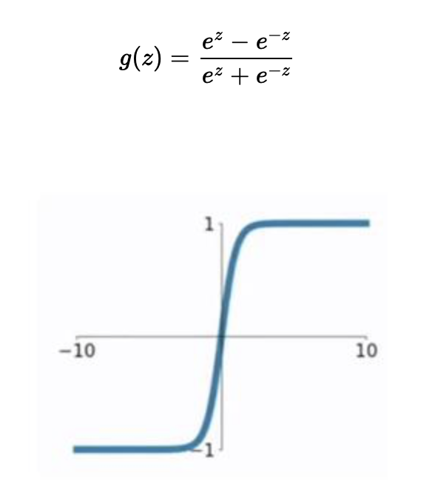
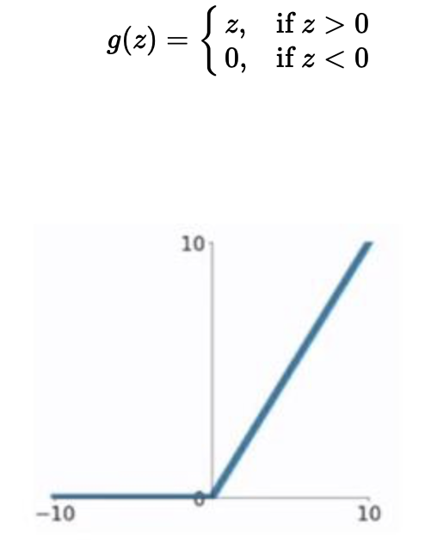
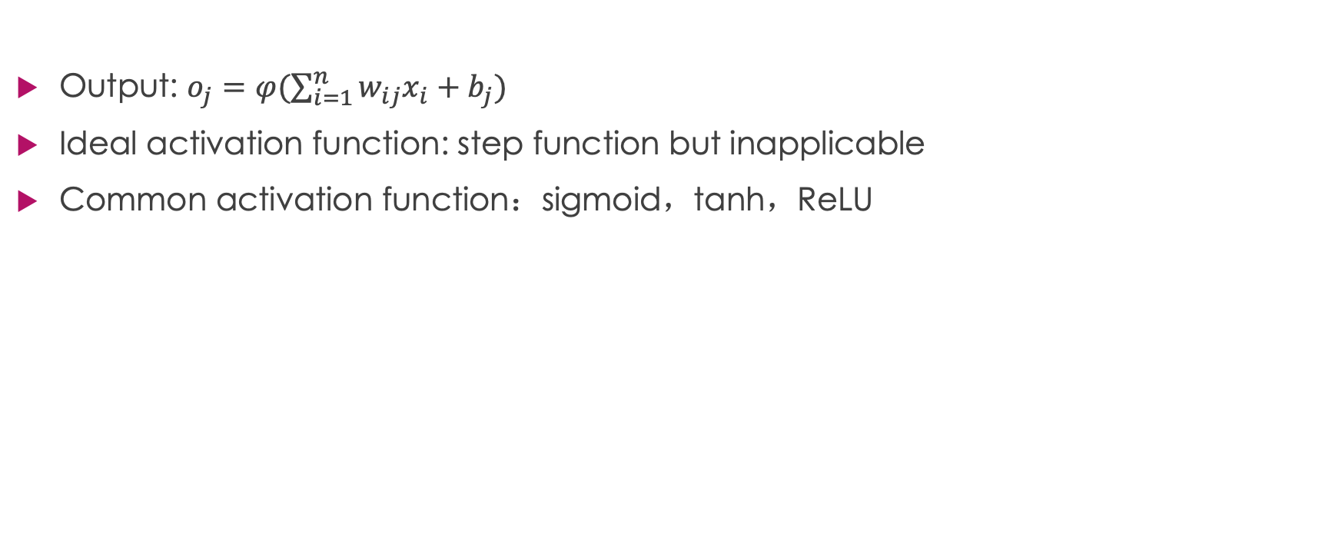
Artificial Neuron Model
Output: $o_{j}=φ(\sum_{i=1}^{n}{{w_{ij}x}_{i}}+b_{j})$
Ideal activation function: step function but inapplicable
Common activation function：sigmoid，tanh，ReLU

Slide 6
Artificial Neural Networks
Consist of multiple artificial neurons
Usually have the structure of an input layer, multiple hidden layers, an output layer
The design of an NN or AutoML aims to design appropriate hidden layers and connection weights.
3-layer Feedforward neural networks

Slide 7
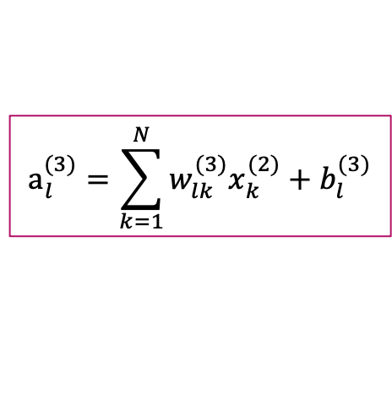
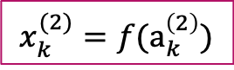

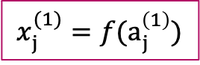

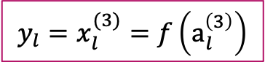
One Inference Process
$$x_{j}^{(1)}=f(a_{j}^{\left(1\right)})$$
$$x_{k}^{(2)}=f(a_{k}^{\left(2\right)})$$
$$y_{l}=x_{l}^{(3)}=f\left(a_{l}^{\left(3\right)}\right)$$
$x=x^{(0)}→a^{(1)}→x^{(1)}$ $→a^{(2)}→x^{(2)}$ $→a^{(3)}→x^{(3)}=y$
$$a_{j}^{(1)}=\sum_{i=1}^{D}{w_{ji}^{(1)}x_{i}^{(0)}}+b_{j}^{(1)}$$
$$a_{k}^{(2)}=\sum_{j=1}^{M}{w_{kj}^{(2)}x_{j}^{(1)}}+b_{k}^{(2)}$$
Superscript of w：layer index
$$a_{l}^{(3)}=\sum_{k=1}^{N}{w_{lk}^{(3)}x_{k}^{(2)}}+b_{l}^{(3)}$$

Slide 8
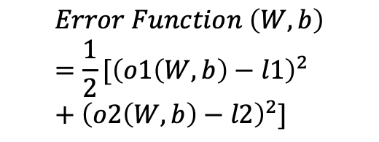
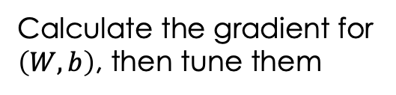
Training of NN
W and Threshold values decide the output of NN
The training is to find appropriate values for W and Threshold
The learning process is to tune weight matrix
x1 | x2 | x3 | l1 | l2
1.0 | 0.1 | 0.3 | 1 | 0
0.1 | 1.5 | 1.2 | 1 | 0
1.1 | 1.1 | 2.0 | 0 | 1
0.2 | 0.2 | 0.3 | 0 | 1
$$Error Function \left(W,b\right)=\frac{1}{2}[{\left(o1\left(W,b\right)−l1\right)}^{2}+{\left(o2\left(W,b\right)−l2\right)}^{2}]$$
Calculate the gradient for $\left(W,b\right)$, then tune them

Slide 9

ANN Application：Handwritten character recognition
http://yann.lecun.com/exdb/lenet/

Slide 10
Performance of ANN
Anti-interference ability, such as different sizes, digital distortion

Slide 11
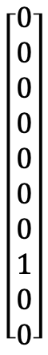
The practice: Handwritten character recognition
The dataset of this practice is a subset of MNIST
A 28*28 grayscale image:
Label:
One-hot vector t:
7
$$\left[\begin{aligned}0 \\ 0 \\ 0 \\ 0 \\ 0 \\ 0 \\ 0 \\ 1 \\ 0 \\ 0\end{aligned}\right]$$
0
1
2
3
4
5
6
7
8
9

Slide 12
Handwritten character recognition ANN network structure
$x=x^{(0)}→a^{(1)}→x^{(1)}$ $→a^{(2)}→x^{(2)}$ $→a^{(3)}→x^{(3)}=y$
Suppose 100 training samples, each sample: 28*28, feature: 784
Layer 1: Input Layer, size D = 784
Layer 2: Hidden Layer 1, size M = 300
Layer 3: Hidden Layer 2, size N = 100
Layer 4: Output Layer, size K = 10
784
300
100
10

Slide 13
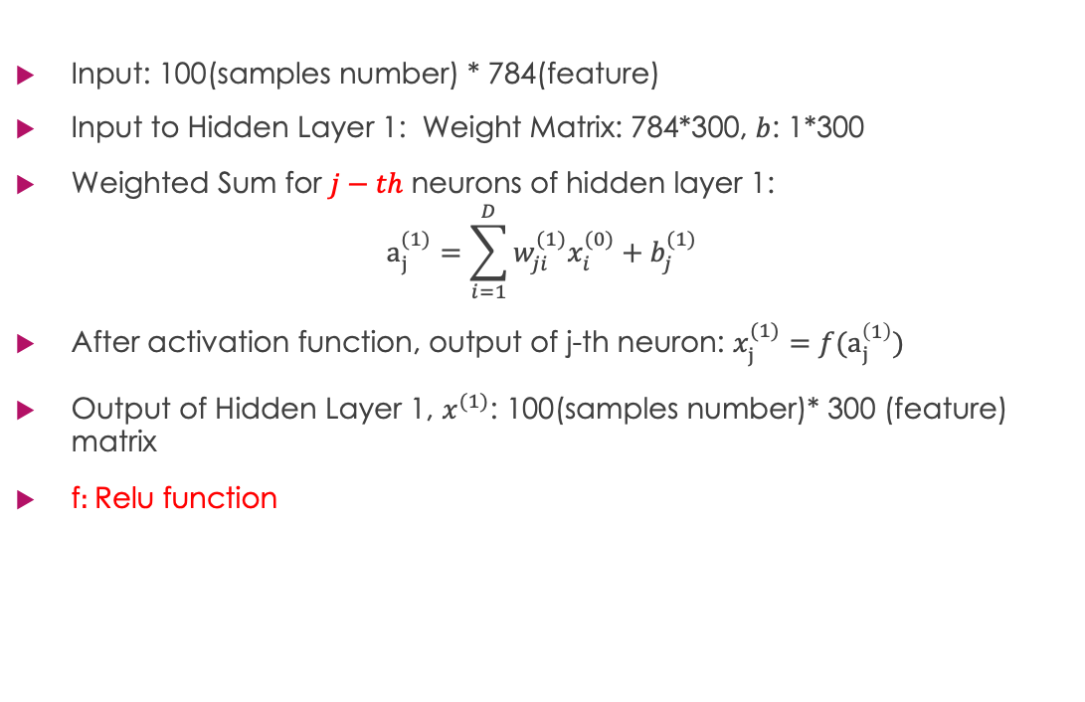
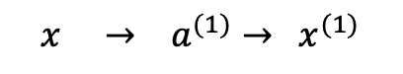
ANN-Input Layer to Hidden Layer 1
$$x → a^{(1)}→{ x}^{(1)}$$
Input: 100(samples number) * 784(feature)
Input to Hidden Layer 1: Weight Matrix: 784*300, $b$: 1*300
Weighted Sum for $j−th$ neurons of hidden layer 1:
$$a_{j}^{(1)}=\sum_{i=1}^{D}{w_{ji}^{(1)}x_{i}^{(0)}}+b_{j}^{(1)}$$
After activation function, output of j-th neuron: $x_{j}^{(1)}=f(a_{j}^{\left(1\right)})$
Output of Hidden Layer 1, $x^{(1)}$: 100(samples number)* 300 (feature) matrix
f$:$Relu function
784
300
100
10
Hidden Layer1

Slide 14
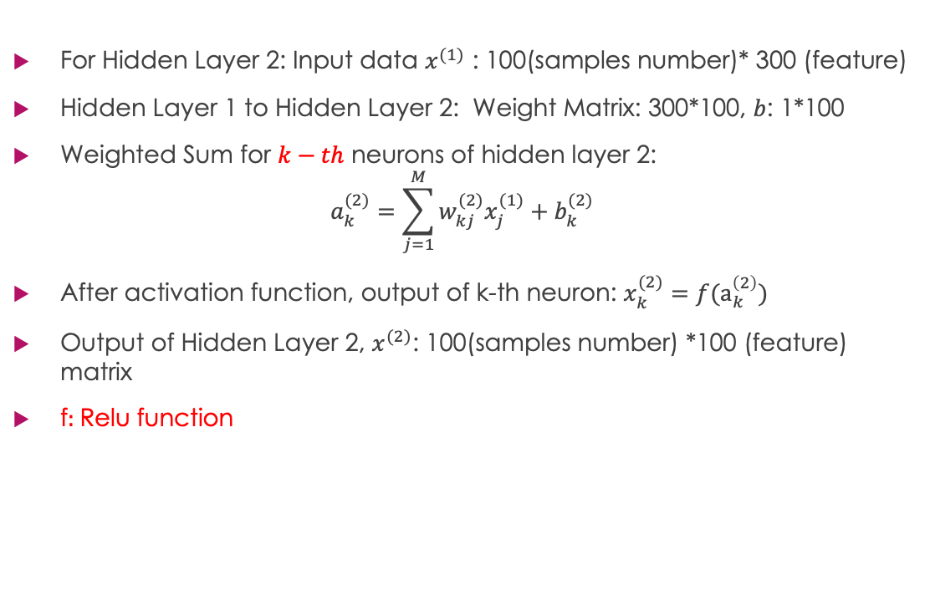
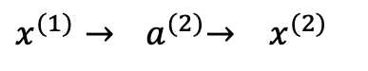
ANN-Hidden Layer 1 to Hidden Layer 2
$x^{(1)}$ $→{ a}^{(2)}→ x^{(2)}$
For Hidden Layer 2: Input data $x^{(1)}$ : 100(samples number)* 300 (feature)
Hidden Layer 1 to Hidden Layer 2: Weight Matrix: 300*100, $b$: 1*100
Weighted Sum for $k−th$ neurons of hidden layer 2:
$$a_{k}^{(2)}=\sum_{j=1}^{M}{w_{kj}^{(2)}x_{j}^{(1)}}+b_{k}^{(2)}$$
After activation function, output of k-th neuron: $x_{k}^{(2)}=f(a_{k}^{\left(2\right)})$
Output of Hidden Layer 2, $x^{(2)}$: 100(samples number) *100 (feature) matrix
f$:$Relu function
784
300
100
10
Hidden Layer2

Slide 15
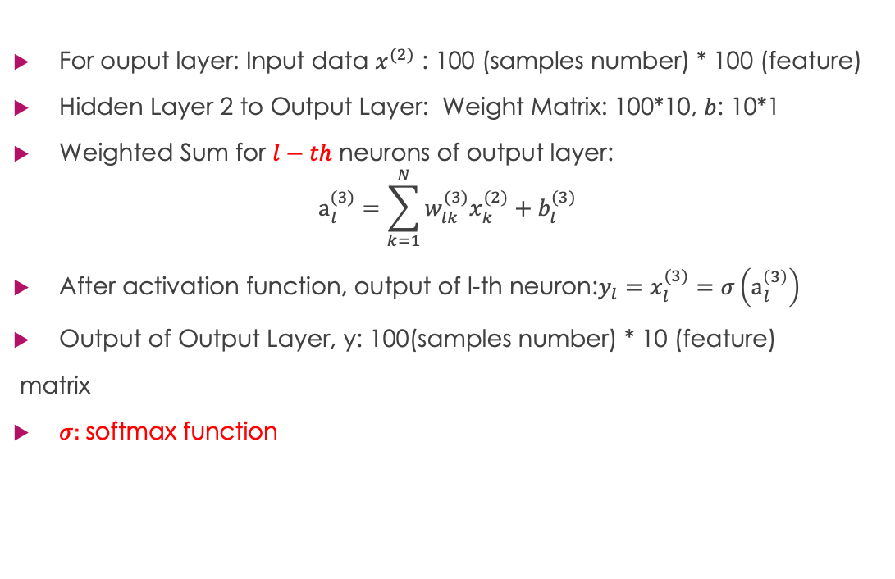
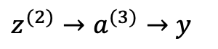
ANN-Hidden Layer 2 to Output Layer
For ouput layer: Input data $x^{(2)}$ : 100 (samples number) * 100 (feature)
Hidden Layer 2 to Output Layer: Weight Matrix: 100*10, $b$: 10*1
Weighted Sum for $l−th$ neurons of output layer:
$$a_{l}^{(3)}=\sum_{k=1}^{N}{w_{lk}^{(3)}x_{k}^{(2)}}+b_{l}^{(3)}$$
After activation function, output of l-th neuron:$y_{l}=x_{l}^{(3)}=σ\left(a_{l}^{\left(3\right)}\right)$
Output of Output Layer, y: 100(samples number) * 10 (feature)
matrix
$σ:$softmax function
$z^{(2)}$ $→a^{(3)}→y$
784
300
100
10

Slide 16
Training of NN
W and Threshold values decide the output of NN
The training is to find appropriate values for W and Threshold so that the output is close to the true value
Given the structure of NN, the learning process is to tune weight matrix in order to in order to minimize the difference between true value and prediction value.

Slide 17
Loss Function and Gradient Descent
How to evaluate the difference？Loss Function
How to tune weight matrix？optimization method (e. g. Gradient Descent)

Slide 18
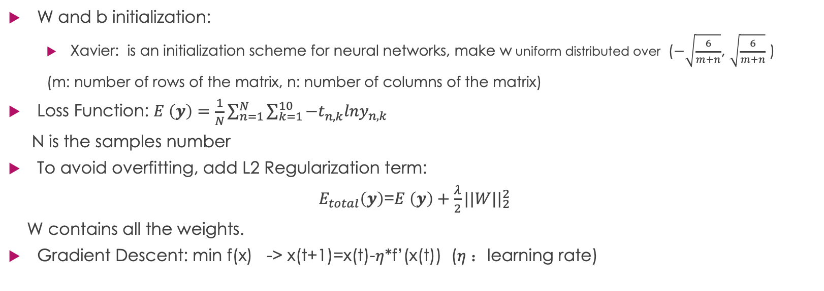
As an Example
W and b initialization:
Xavier: is an initialization scheme for neural networks, make w uniform distributed over ($−\sqrt{\frac{6}{m+n}}$, $\sqrt{\frac{6}{m+n}}$ )
(m: number of rows of the matrix, n: number of columns of the matrix)
Loss Function: $E \left(y\right)=\frac{1}{N}\sum_{n=1}^{N}{\sum_{k=1}^{10}{−t_{n,k}^{}lny_{n,k}}}$
N is the samples number
To avoid overfitting, add L2 Regularization term:
$E_{total}\left(y\right)$=$E \left(y\right)+\frac{λ}{2}{||W||}_{2}^{2}$
W contains all the weights.
Gradient Descent: min f(x) -> x(t+1)=x(t)-$η$*f’(x(t)) ($η$：learning rate)

Slide 19

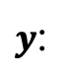
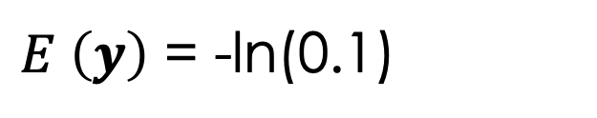
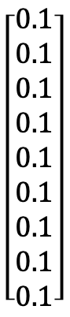
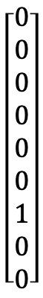
Loss
A 28*28 grayscale image:
Label:
$t$:
$$\left[\begin{aligned}0 \\ 0 \\ 0 \\ 0 \\ 0 \\ 0 \\ 1 \\ 0 \\ 0\end{aligned}\right]$$
7
$y$:
$$\left[\begin{aligned}0.1 \\ 0.1 \\ 0.1 \\ 0.1 \\ 0.1 \\ 0.1 \\ 0.1 \\ 0.1 \\ 0.1\end{aligned}\right]$$
$E \left(y\right)$ = -ln(0.1)

Slide 20
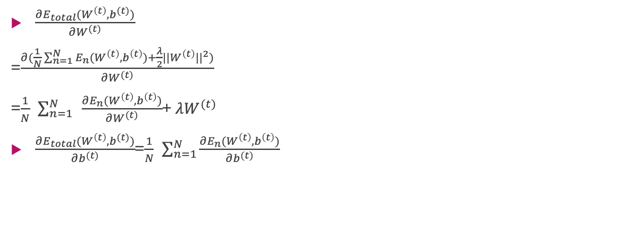
Gradient Descent
$\frac{∂E_{total}(W^{\left(t\right)},b^{(t)})}{∂W^{(t)}}$
=$\frac{∂(\frac{1}{N}\sum_{n=1}^{N}{E_{n}(W^{\left(t\right)},b^{\left(t\right)})}+\frac{λ}{2}{{||W}^{\left(t\right)}||}^{2})}{∂W^{(t)}}$
=$\frac{1}{N}$ $\sum_{n=1}^{N}{ }\frac{∂E_{n}(W^{\left(t\right)},b^{\left(t\right)})}{∂W^{(t)}}$+ $λW^{(t)}$
$\frac{∂E_{total}(W^{\left(t\right)},b^{(t)})}{∂b^{(t)}}$=$\frac{1}{N}$ $\sum_{n=1}^{N}{\frac{∂E_{n}(W^{\left(t\right)},b^{\left(t\right)})}{∂b^{(t)}}}$

Slide 21
Chain Rule Review
Chain rule: to find the derivative of a composite function
If h(x)=f(g(x))，then h’ (x)=f’(g(x))g’(x)
E.g.: f(x)=2x+2，g(x)=3x+3，g(f(x)) is a composite function, g′(f(x))=6

Slide 22
One Inference Process
$$x_{j}^{(1)}=f(a_{j}^{\left(1\right)})$$
$$x_{k}^{(2)}=f(a_{k}^{\left(2\right)})$$
$$y_{l}=x_{l}^{(3)}=f\left(a_{l}^{\left(3\right)}\right)$$
$x=x^{(0)}→a^{(1)}→x^{(1)}$ $→a^{(2)}→x^{(2)}$ $→a^{(3)}→x^{(3)}=y$
$$a_{j}^{(1)}=\sum_{i=1}^{D}{w_{ji}^{(1)}x_{i}^{(0)}}+b_{j}^{(1)}$$
$$a_{k}^{(2)}=\sum_{j=1}^{M}{w_{kj}^{(2)}x_{j}^{(1)}}+b_{k}^{(2)}$$
Superscript of w：layer index
$$a_{l}^{(3)}=\sum_{k=1}^{N}{w_{lk}^{(3)}x_{k}^{(2)}}+b_{l}^{(3)}$$

Slide 23

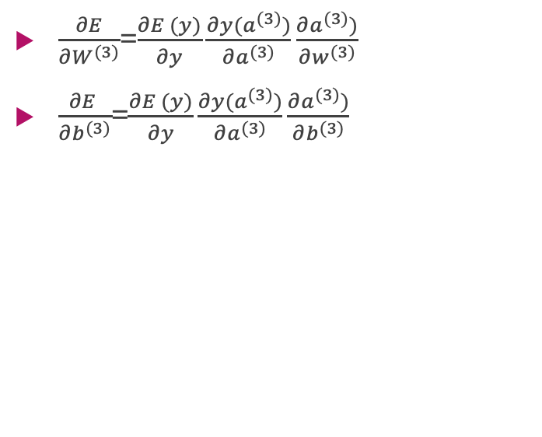
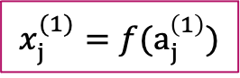


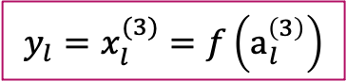

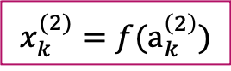
Derivative of E on $w^{(3)}$, $b^{(3)}$
$$x_{j}^{(1)}=f(a_{j}^{\left(1\right)})$$
$$x_{k}^{(2)}=f(a_{k}^{\left(2\right)})$$
$$y_{l}=x_{l}^{(3)}=f\left(a_{l}^{\left(3\right)}\right)$$
$\frac{∂E}{∂W^{(3)}}$=$\frac{∂E (y)}{∂y}\frac{∂y(a^{(3)})}{∂a^{(3)}}\frac{∂a^{(3)})}{∂w^{(3)}}$
$\frac{∂E }{∂b^{(3)}}$=$\frac{∂E (y)}{∂y}\frac{∂y(a^{(3)})}{∂a^{(3)}}\frac{∂a^{(3)})}{∂b^{(3)}}$
$x=x^{(0)}→a^{(1)}→x^{(1)}$ $→a^{(2)}→x^{(2)}$ $→a^{(3)}→x^{(3)}=y$
$$a_{j}^{(1)}=\sum_{i=1}^{D}{w_{ji}^{(1)}x_{i}^{(0)}}+b_{j}^{(1)}$$
$$a_{k}^{(2)}=\sum_{j=1}^{M}{w_{kj}^{(2)}x_{j}^{(1)}}+b_{k}^{(2)}$$
$$a_{l}^{(3)}=\sum_{k=1}^{N}{w_{lk}^{(3)}x_{k}^{(2)}}+b_{l}^{(3)}$$

Slide 24
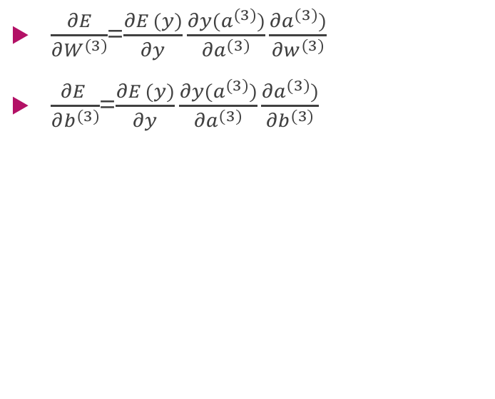

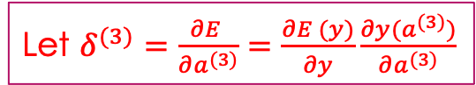
Derivative of E on $w^{(3)}$, $b^{(3)}$
$$x_{j}^{(1)}=f(a_{j}^{\left(1\right)})$$
$$x_{k}^{(2)}=f(a_{k}^{\left(2\right)})$$
$$y_{l}=x_{l}^{(3)}=f\left(a_{l}^{\left(3\right)}\right)$$
$\frac{∂E}{∂W^{(3)}}$=$\frac{∂E (y)}{∂y}\frac{∂y(a^{(3)})}{∂a^{(3)}}\frac{∂a^{(3)})}{∂w^{(3)}}$
$\frac{∂E }{∂b^{(3)}}$=$\frac{∂E (y)}{∂y}\frac{∂y(a^{(3)})}{∂a^{(3)}}\frac{∂a^{(3)})}{∂b^{(3)}}$
$x=x^{(0)}→a^{(1)}→x^{(1)}$ $→a^{(2)}→x^{(2)}$ $→a^{(3)}→x^{(3)}=y$
$$a_{j}^{(1)}=\sum_{i=1}^{D}{w_{ji}^{(1)}x_{i}^{(0)}}+b_{j}^{(1)}$$
Let $δ^{(3)}=\frac{∂E }{∂a^{(3)}}=\frac{∂E (y)}{∂y}\frac{∂y(a^{(3)})}{∂a^{(3)}}$
$$a_{k}^{(2)}=\sum_{j=1}^{M}{w_{kj}^{(2)}x_{j}^{(1)}}+b_{k}^{(2)}$$
$$a_{l}^{(3)}=\sum_{k=1}^{N}{w_{lk}^{(3)}x_{k}^{(2)}}+b_{l}^{(3)}$$

Slide 25
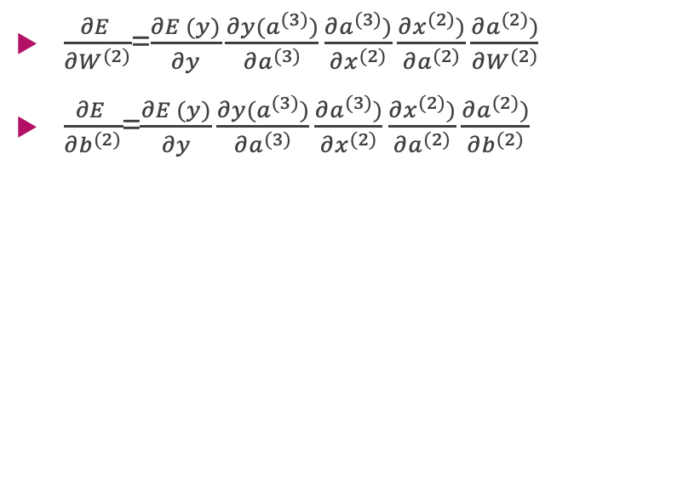

Derivative of E on $w^{(2)}$, $b^{(2)}$
$$x_{j}^{(1)}=f(a_{j}^{\left(1\right)})$$
$$x_{k}^{(2)}=f(a_{k}^{\left(2\right)})$$
$$y_{l}=x_{l}^{(3)}=f\left(a_{l}^{\left(3\right)}\right)$$
$\frac{∂E }{∂W^{(2)}}$=$\frac{∂E (y)}{∂y}\frac{∂y(a^{(3)})}{∂a^{(3)}}\frac{∂a^{(3)})}{∂x^{(2)}}\frac{∂x^{(2)})}{∂a^{(2)}}\frac{∂a^{(2)})}{∂W^{(2)}}$
$\frac{∂E }{∂b^{(2)}}$=$\frac{∂E (y)}{∂y}\frac{∂y(a^{(3)})}{∂a^{(3)}}\frac{∂a^{(3)})}{∂x^{(2)}}\frac{∂x^{(2)})}{∂a^{(2)}}\frac{∂a^{(2)})}{∂b^{(2)}}$
$x=x^{(0)}→a^{(1)}→x^{(1)}$ $→a^{(2)}→x^{(2)}$ $→a^{(3)}→x^{(3)}=y$
$$a_{j}^{(1)}=\sum_{i=1}^{D}{w_{ji}^{(1)}x_{i}^{(0)}}+b_{j}^{(1)}$$
$$a_{k}^{(2)}=\sum_{j=1}^{M}{w_{kj}^{(2)}x_{j}^{(1)}}+b_{k}^{(2)}$$
$$a_{l}^{(3)}=\sum_{k=1}^{N}{w_{lk}^{(3)}x_{k}^{(2)}}+b_{l}^{(3)}$$

Slide 26


Derivative of E on $w^{(2)}$, $b^{(2)}$
$$x_{j}^{(1)}=f(a_{j}^{\left(1\right)})$$
$$x_{k}^{(2)}=f(a_{k}^{\left(2\right)})$$
$$y_{l}=x_{l}^{(3)}=f\left(a_{l}^{\left(3\right)}\right)$$
$\frac{∂E }{∂W^{(2)}}$=$\frac{∂E (y)}{∂y}\frac{∂y(a^{(3)})}{∂a^{(3)}}\frac{∂a^{(3)})}{∂x^{(2)}}\frac{∂x^{(2)})}{∂a^{(2)}}\frac{∂a^{(2)})}{∂W^{(2)}}$
$\frac{∂E }{∂b^{(2)}}$=$\frac{∂E (y)}{∂y}\frac{∂y(a^{(3)})}{∂a^{(3)}}\frac{∂a^{(3)})}{∂x^{(2)}}\frac{∂x^{(2)})}{∂a^{(2)}}\frac{∂a^{(2)})}{∂b^{(2)}}$
$x=x^{(0)}→a^{(1)}→x^{(1)}$ $→a^{(2)}→x^{(2)}$ $→a^{(3)}→x^{(3)}=y$
$$a_{j}^{(1)}=\sum_{i=1}^{D}{w_{ji}^{(1)}x_{i}^{(0)}}+b_{j}^{(1)}$$
Let $δ^{(2)}=\frac{∂E (y)}{∂y}\frac{∂y(a^{(3)})}{∂a^{(3)}}\frac{∂a^{(3)})}{∂x^{(2)}}\frac{∂x^{(2)})}{∂a^{(2)}}=\frac{∂E}{∂a^{(2)}}$
$$a_{k}^{(2)}=\sum_{j=1}^{M}{w_{kj}^{(2)}x_{j}^{(1)}}+b_{k}^{(2)}$$
$$a_{l}^{(3)}=\sum_{k=1}^{N}{w_{lk}^{(3)}x_{k}^{(2)}}+b_{l}^{(3)}$$

Slide 27

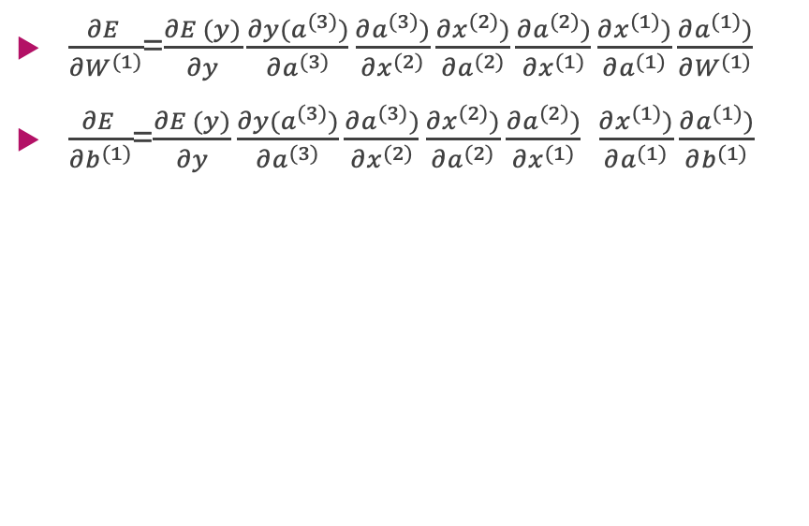
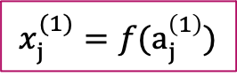


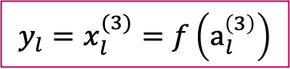

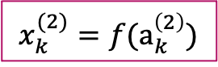
Derivative of E on $w^{(1)}$, $b^{(1)}$
$$x_{j}^{(1)}=f(a_{j}^{\left(1\right)})$$
$$x_{k}^{(2)}=f(a_{k}^{\left(2\right)})$$
$$y_{l}=x_{l}^{(3)}=f\left(a_{l}^{\left(3\right)}\right)$$
$\frac{∂E }{∂W^{(1)}}$=$\frac{∂E (y)}{∂y}\frac{∂y(a^{(3)})}{∂a^{(3)}}\frac{∂a^{(3)})}{∂x^{(2)}}\frac{∂x^{(2)})}{∂a^{(2)}}\frac{∂a^{(2)})}{∂x^{(1)}}\frac{∂x^{(1)})}{∂a^{(1)}}\frac{∂a^{(1)})}{∂W^{(1)}}$
$\frac{∂E }{∂b^{(1)}}$=$\frac{∂E (y)}{∂y}\frac{∂y(a^{(3)})}{∂a^{(3)}}\frac{∂a^{(3)})}{∂x^{(2)}}\frac{∂x^{(2)})}{∂a^{(2)}}\frac{∂a^{(2)})}{∂x^{(1)}}$ $\frac{∂x^{(1)})}{∂a^{(1)}}\frac{∂a^{(1)})}{∂b^{(1)}}$
$x=x^{(0)}→a^{(1)}→x^{(1)}$ $→a^{(2)}→x^{(2)}$ $→a^{(3)}→x^{(3)}=y$
$$a_{j}^{(1)}=\sum_{i=1}^{D}{w_{ji}^{(1)}x_{i}^{(0)}}+b_{j}^{(1)}$$
$$a_{k}^{(2)}=\sum_{j=1}^{M}{w_{kj}^{(2)}x_{j}^{(1)}}+b_{k}^{(2)}$$
$$a_{l}^{(3)}=\sum_{k=1}^{N}{w_{lk}^{(3)}x_{k}^{(2)}}+b_{l}^{(3)}$$

Slide 28
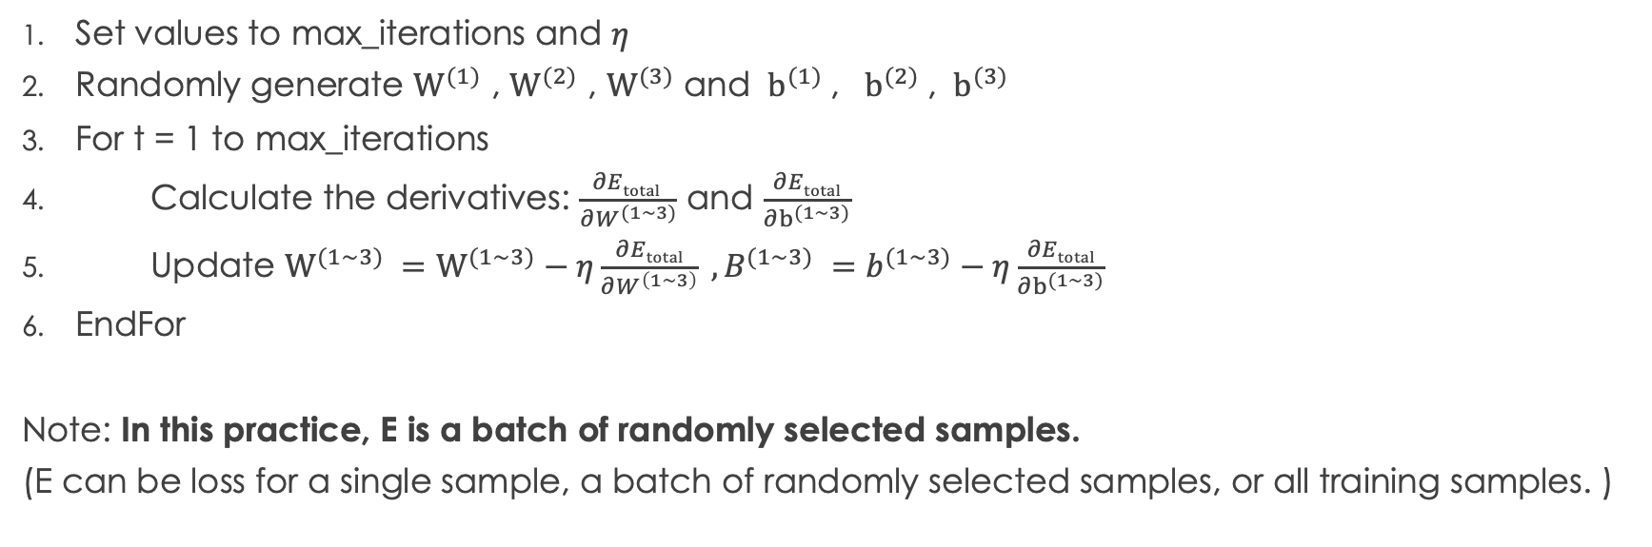
Gradient Descent Process (BP Algorithm)
Set values to max_iterations and $η$
Randomly generate $W^{(1)}$ , $W^{(2)}$ , $W^{(3)}$ and ${ b}^{(1)}$, ${ b}^{(2)}$, ${ b}^{(3)}$
For t = 1 to max_iterations
Calculate the derivatives: $\frac{∂Etotal }{∂W^{(1\sim 3)}}$ and $\frac{∂Etotal}{∂b^{(1\sim 3)}}$
Update $W^{(1\sim 3)} =W^{(1\sim 3)}−η\frac{∂Etotal}{∂W^{\left(1\sim 3\right)}} , B^{(1\sim 3)} =b^{(1\sim 3)}−η\frac{∂Etotal}{∂b^{(1\sim 3)}}$
EndFor
Note: In this practice, E is a batch of randomly selected samples.
(E can be loss for a single sample, a batch of randomly selected samples, or all training samples. )

